Slide 1
Technology’s Role in What Happens in the World of Insurance

Slide 2
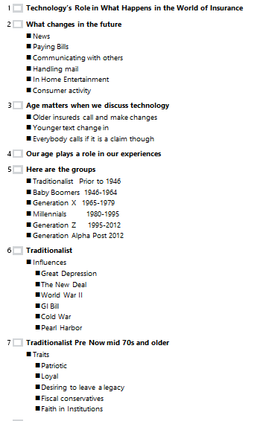

Slide 3
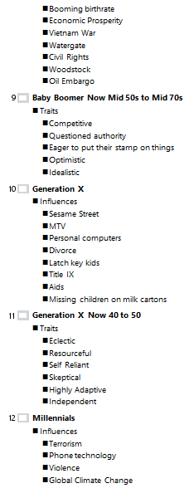

Slide 4
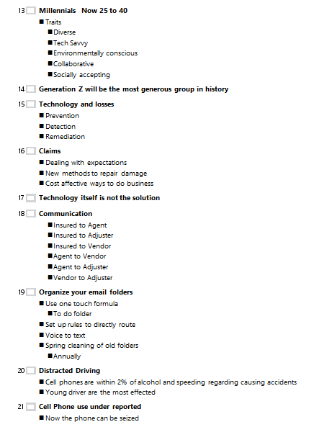

Slide 5
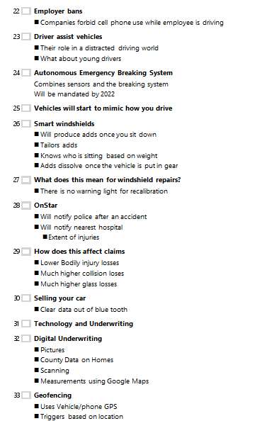

Slide 6
What changes in the future
News
Paying Bills
Communicating with others
Handling mail
In Home Entertainment
Consumer activity

Slide 7
Age matters when we discuss technology
Older insureds call and make changes
Younger text change in
Everybody calls if it is a claim though
Notes:
Dick Egan internet story
My dad and his typewriter

Slide 8
Our age plays a role in our experiences
Notes:
We are all shaped by events in our life

Slide 9
Here are the groups
Traditionalist Prior to 1946
Baby Boomers 1946-1964
Generation X 1965-1979
Millennials 1980-1995
Generation Z 1995-2012
Generation Alpha Post 2012
Notes:
1946 World war 2 ended and time of plenty

Slide 10
Traditionalist
Influences
Great Depression
The New Deal
World War II
GI Bill
Cold War
Pearl Harbor
Notes:
Depression---Hoarders
New Deal--- Helping those legitimately hurting
World War 11----Sense of duty
GI Bill Using help to self improve and not be dependent One time aid
Cold War Health distrust Leery of that which is different
Pearl harbor Fear, then Sacrifice and retaliation

Slide 11
Traditionalist Pre Now mid 70s and older
Traits
Patriotic
Loyal
Desiring to leave a legacy
Fiscal conservatives
Faith in Institutions
Notes:
Leave a legacy Public construction projects (School upgrade)
Fiscal conservative because they saw poverty
Pro government and government programs

Slide 12
Baby Boomers
Influences
Booming birthrate
Economic Prosperity
Vietnam War
Watergate
Civil Rights
Woodstock
Oil Embargo
Notes:
Birthrate----------Exploding need for schools
Prosperity--------never saw time of need (Everything will work out) (Rekick in backyard football)
Vietnam/Watergate----Lost trust in government
Civil Rights-------Questioned accepted norms and changed them
Woodstock-------Allowed deviance and think in the moment living (Don’t worry)
Oil Embargo------Realized it is only one world and we a reliant on other countries

Slide 13
Baby Boomer Now Mid 50s to Mid 70s
Traits
Competitive
Questioned authority
Eager to put their stamp on things
Optimistic
Idealistic
Notes:
Birthrate boom -------caused more competition
Public mistakes -------caused doubting to mount
Their own stamp------Desire to change the culture permanently
Optimistic--------- Rarely incurred negative consequences or down side (Bailed out) Nonpractical majors in college
Idealistic-------------Convinced social safety nets would save them (Government, insurance, inflation)

Slide 14
Generation X
Influences
Sesame Street
MTV
Personal computers
Divorce
Latch key kids
Title IX
Aids
Missing children on milk cartons
Notes:
Sesame street----- Softer educating Fun learning
MTV---------------Fluid values much more direct entertaining harder to be entertains
Computers No more rote memory You can know so much more much easier
Divorce-----------Acceptance of breaking up family
Latch key kids-----Unsupervised time after school (Experimenting) yet park and rec structured evenings
Title IX------------Equity in opportunity Iowa girls hoops Dad at Beckys game
Aids---------------Consequences for violating values and morals Society diminishing consequence for decisions
Milk carton kids----Realizing and exposing evil occurring

Slide 15
Generation X Now 40 to 50
Traits
Eclectic
Resourceful
Self Reliant
Skeptical
Highly Adaptive
Independent
Notes:
Sesame and MTV Computers------Broad exposure causes broad taste and tolerances
Divorce-------------Self reliant not secure about family life and skeptical
Latch key---------Resourceful Figures things out themselves and self reliant
Title IX----------Adaptive for they have seen norms change

Slide 16
Millennials
Influences
Terrorism
Phone technology
Violence
Global Climate Change
Notes:
Diverse------Accepting of the differences of others
Tech Savvy----Just know what button to push
Environment------Big picture concerned

Slide 17
Millennials Now 25 to 40
Traits
Diverse
Tech Savvy
Environmentally conscious
Collaborative
Socially accepting

Slide 18
Generation Z will be the most generous group in history

Slide 19
Technology and losses
Prevention
Detection
Remediation
Notes:
Prevention Driver assist vehicles Airbags and sensors less medical more collision costs
Detection GPS Where and when Ben buying catsup
We will talk about adjusting losses and digital pictures

Slide 20
Claims
Dealing with expectations
New methods to repair damage
Cost affective ways to do business

Slide 21
Technology itself is not the solution
Notes:
Owning tools does not make you handy

Slide 22
Communication
Insured to Agent
Insured to Adjuster
Insured to Vendor
Agent to Vendor
Agent to Adjuster
Vendor to Adjuster
Notes:
Claims today feel like they are between the shop and the carrier instead of the insured

Slide 23
Organize your email folders
Use one touch formula
To do folder
Set up rules to directly route
Voice to text
Spring cleaning of old folders
Annually

Slide 24
Distracted Driving
Cell phones are within 2% of alcohol and speeding regarding causing accidents
Young driver are the most effected
Notes:
Some carriers affect your rate if you have a data plan on your phone

Slide 25
Cell Phone use under reported
Now the phone can be seized
Notes:
They can find out where the phone was and when it was there
They know exact time of usage you called but they don’t know what you said

Slide 26
Employer bans
Companies forbid cell phone use while employee is driving

Slide 27
Driver assist vehicles
Their role in a distracted driving world
What about young drivers
Notes:
Distracted driving
1 in 3 drivers drive distracted every week
Hands free has not made a big difference

Slide 28
Autonomous Emergency Breaking System
Combines sensors and the breaking system
Will be mandated by 2022

Slide 29
Vehicles will start to mimic how you drive
Notes:
Including adjusting seats
Based on weight they know which spouse is sitting down

Slide 30
Smart windshields
Will produce adds once you sit down
Tailors adds
Knows who is sitting based on weight
Adds dissolve once the vehicle is put in gear

Slide 31
What does this mean for windshield repairs?
There is no warning light for recalibration
Notes:
19 out of 20 claims are glass
This will be big

Slide 32
OnStar
Will notify police after an accident
Will notify nearest hospital
Extent of injuries

Slide 33
How does this affect claims
Lower Bodily injury losses
Much higher collision loses
Much higher glass losses

Slide 34
Selling your car
Clear data out of blue tooth

Slide 35
Technology and Underwriting
Notes:
Mapquest
Google Map
Google Earth
MLS Sites with pictures
County Property Websites

Slide 36
Digital Underwriting
Pictures
County Data on Homes
Scanning
Measurements using Google Maps

Slide 37
Geofencing
Uses Vehicle/phone GPS
Triggers based on location
Know your drive utilizes this and sells your data

Slide 38
Other Underwriting benefits of technology
Agent ordered reports
Credit data
Risk vs Premium
Data Privacy
Notes:
Accurate Risk evaluation immediately Block Binds
Privacy
Public WIFI bad
Airplane Mode to kill tracking

Slide 39
Underwriting
Fair Credit Reporting Act
The Fair Credit Reporting Act requires that you provide an applicant with written notice of the possibility that we might order an investigative report. Therefore, you must provide the applicant with either a copy of the application or Form U76. The application copy or the form must be given to the applicant at the time the application is taken. The application must be signed by both you and the applicant.

Slide 40
How Auto violations are recorded
Notes:
People can buy off tickets so they are not on your record

Slide 41
Timeline of a ticket

Slide 42
Does a Ticket go to all States?
Yes

Slide 43
How to remedy incorrect tickets
http://mncourts.gov/Find-Courts.aspx

Slide 44
How does Technology help?
Combine ratios is at 110%
Technology allows the cost of losses to drop
Technology allows for high customer satisfaction
Website for loss ratios
http://mn.gov/commerce-stat/pdfs/property-casualty.pdf
Notes:
State Farm 66.5%
American Family 54.3%
USAA 67.0%
Allstate 47.8%
Farmers (Zurich) 62.2%

Slide 45
Photo Claims Adjusting
Convenience at a cost
Estimates tend to be low
You need to inspect vehicles
Or get 2 photos
Notes:
Takes advantage of people not fixing their car

Slide 46
New Methods to repair Damage
Fire Losses
Water Losses

Slide 47
Smoke damage

Slide 48
Water Damage
Three stages of matter
Solid
Liquid
Vapor
Notes:
Water Losses
Meters
Air Wolf mat for hardwood floors
Tess

Slide 49
TESS Technology

Slide 50
Marketing Technology
Online County Data

Slide 51
Documenting
Outlook tracking tasks
Tickler files (Reminders)
Scanning
Notes:
Dedicate regular time to this
Keep a wish list

Slide 52
Tasks
Help
Type in Tasks
Select what you want to learn

Slide 53
Verifying/Documenting Coverage
Binders
Certificate

Slide 54
Binders
5 Day rule

Slide 55
Renewals
Effective File reviews
Review what they have
Look at what may have changed
Send Summary Letter
Offering time to sit down
Notes:
PIR 2 letter system

Slide 56
Billing
Online banking
ID Theft
Company Notifications
Mortgage Escrows
Notes:
Online banking delays in making payment Check with bank
Demographics have changed Younger and Younger
Competition Flat premiums but attrition
Priority on growth and new business
Communication expectations
Mobility (Smart Phones)
Flexibility Self Employed with uneven income
Billing is a customer service now not business process
73% touch points are billing
Texting billing/payment

Slide 57
What Websites do not do
Advise
Empathize
Read Emotions
Build Relationships

Slide 58
What Websites can do
The new front door to your agency
Effectively flow work to the right people
Offer Services
Increase availability of some information
Notes:
Social Media
What has changed in customer life
What messages to send
What products to offer
But customers can complain online easily

